Slide 1

Theory of Computation
Finite Automata
Yang, Ning
(杨 宁)
School of Computer Science
2020.02
Notes:
1

Slide 2

Content
Why Study Automata Theory
Informal Introduction to Finite Automata
Central Concepts of Automata Theory
Deterministic Finite Automata (DFA)
Nondeterministic Finite Automata(NFA)

Slide 3
Why Study Automata Theory
Automata is the mathematical model of computer and even any computing systems
Automata are essential for the study of the limits of computation:
What can a computer do at all? (Computability or Decidability)
What can a computer do efficiently? (Complexity or Intractability)

Slide 4
Other Good Stuff
Used for both design and verification of circuits and communication protocols
Used for many text-processing applications
An important component of compilers
Describes simple patterns of events, etc.

Slide 5
Content
Why Study Automata Theory
Informal Introduction to Finite Automata
Central Concepts of Automata Theory
Deterministic Finite Automata (DFA)
Nondeterministic Finite Automata(NFA)

Slide 6
What is a Finite Automaton
A formal system
Remembers only a finite amount of information
Information represented by its state
State changes in response to inputs
Rules that tell how the state changes in response to inputs are called transitions

Slide 7
Example: Tennis
Match = 3~5 sets
Set = 6 or more games
One person serves throughout
To win, you must score at least 4 points
You also must win by at least 2 points
Inputs are s = “server wins point” and o = “opponent wins point”

Slide 8
Server
Wins
s
40-Love
s
s
s
Ad-in
30-Love
o
s
s
40-15
o
o
s
o
Start
15-Love
30-15
40-30
s
s
s
s
o
o
o
Love
15-all
30-all
deuce
o
s
s
s
o
o
15-30
30-40
Love-15
s
s
o
o
o
s
Love-30
15-40
s
o
o
Ad-out
Love-40
o
o
o
Opp’nt
Wins
Notes:
It is common to represent a FA by a graph, with nodes for states and arrows labeled by the input for transitions. Here’s the first state of the automaton that scores tennis games. The name of this state is LOVE. You may ask what’s love got to do -- got to do -- with it, but that’s what “zero” is called in tennis.
Click 1
The state “Love” represents the history in which nothing has happened, and we indicate that history begins with this state by an arrow labeled START.
Click 2
The first point will be won by one of the two players, so there are two transitions out of LOVE, one labeled s the other o. Here are the transitions and new states. You might think the names of the states would be 1-0 and 0-1 – the server’s score always goes first. But they’re not. In tennis, there is the fiction that you score 15 for winning a point. And 0 isn’t 0; it’s LOVE.
Click 3
The next point can lead to three states, two where one player has won both points, and one where they’re tied at one each. Here are the states with their names.
There is something interesting about the 15-all state. It has forgotten how we got there. We know the sequence of inputs was either s-o or o-s, but we don’t know which. It doesn’t matter, of course. That’s a good thing about FA; they only remember what must be remembered. In state 15-all, the question of who won the first of the two points can’t have any effect on the outcome.
Click 4
After another point, there are four new states the game could be in. They have the expected names, except people are too lazy to say “45” so they just say “40.”
Click 5
Now, let’s look at the transitions from the state 40-love. The server is well ahead and can win on the next point. If the server wins, we go to a state indicating that win. The game is over, and the automaton has no further moves. We indicate this “output” of the automaton by calling this state a FINAL state, and we indicate it is final by a double circle.
There is another final state reachable from the state love-40, if the next input indicates the opponent won the fourth point.
Click 6
There are three other new states as well, called 40-15, 30-all, and 15-40. Each indicates that four points have been played, with 3, 2, or 1 of these points won by the server.
Click 7
From the 40-15 state, if the server wins the point, we go to the “server won” state, but if the opponent wins the point we go to a new state called 40-30.
A similar thing happens from 15-40, and from 30-all we can go to either the 40-30 or the 30-40 state.
Click 8
Now, let’s look at state 40-30. If the server wins the next point, they’ve won the game, but if the opponent wins, then the game is tied. The name for this state is DEUCE. The deuce state is quite interesting. It remembers that the game is tied, but it remembers neither the sequence of wins and losses of points nor even how many points have been played.
The 30-40 state is handled similarly.
Click 9
Next, consider what happens in DEUCE. You have to win by two points, so it is impossible for either player to win immediately. If the server wins the next point, they are ahead by one point, although we don’t know how many points in total have been played. The strange name for this state is AD-IN (advantage “in”). “In” refers to the server. Symmetrically, if the opponent wins in state DEUCE, we go to state AD-OUT --- the “out” refers to the opponent.
Click 10
Then, in state ad-in, if the server wins the next point they win the game. But if the opponent wins, you are back to deuce. Likewise, from ad-out, a server win puts you back in deuce, but an opponent win gives the opponent the game.
We can now look at the entire TRANSITION DIAGRAM for the FA. While most of it just allows flow away from the start state, the loops involving deuce, ad-in, and ad-out allow for cycles and for an infinite number of possible strings of s’s and o’s to lead to one of the final states.

Slide 9
Acceptance of Inputs
Given a sequence of inputs (input string), start in the start state and follow the transition from each symbol in turn.
Input is accepted if you wind up in a final (accepting) state after all inputs have been read.
The job of an automaton is to process strings of input symbols or inputs strings.

Slide 10
Example: Processing a String
s o s o s o s o s o s s
Server
Wins
s
40-Love
s
s
s
Ad-in
30-Love
o
s
s
40-15
o
o
s
o
Start
15-Love
30-15
40-30
s
s
s
s
o
o
o
Love
15-all
30-all
o
deuce
*
s
s
s
o
o
30-40
Love-15
15-30
s
s
o
o
Love-30
o
15-40
s
o
s
o
Love-40
o
Ad-out
o
o
Opp’nt
Wins
Notes:
Here is our input string (POINT). It represents a game in which the server and opponent alternate winning points, until at the very end (POINT) the server wins two in a row.
We’ll mark the current state by the star (POINT). Initially the current state is the start state. That’s where all finite automata start out.
The arrow (POINT) indicates which input we are about to process. So here, we are about to process the first event, where the server wins the first point. We’re going to follow the transition out of state LOVE labeled s (POINT).

Slide 11
Example: Processing a String
s o s o s o s o s o s s
Server
Wins
s
40-Love
s
s
s
Ad-in
30-Love
o
s
*
s
40-15
o
o
s
o
Start
15-Love
30-15
40-30
s
s
s
s
o
o
o
Love
15-all
30-all
o
deuce
s
s
s
o
o
30-40
Love-15
15-30
s
s
o
o
Love-30
o
15-40
s
o
s
o
Love-40
o
Ad-out
o
o
Opp’nt
Wins
Notes:
Here, we’ve made the first transition. The next input is o (POINT), and we’re in state 15-love (POINT).
The transition from that state on o is to state 15-all.

Slide 12
Example: Processing a String
s o s o s o s o s o s s
Server
Wins
s
40-Love
s
s
s
Ad-in
30-Love
o
s
s
40-15
o
o
s
o
Start
15-Love
*
30-15
40-30
s
s
s
s
o
o
o
Love
15-all
30-all
o
deuce
s
s
s
o
o
30-40
Love-15
15-30
s
s
o
o
Love-30
o
15-40
s
o
s
o
Love-40
o
Ad-out
o
o
Opp’nt
Wins
Notes:
In state 15-all, we see another s on the input, so we go to state 30-15.

Slide 13
Example: Processing a String
s o s o s o s o s o s s
Server
Wins
s
40-Love
s
s
s
Ad-in
30-Love
o
s
s
*
40-15
o
o
s
o
Start
15-Love
30-15
40-30
s
s
s
s
o
o
o
Love
15-all
30-all
o
deuce
s
s
s
o
o
30-40
Love-15
15-30
s
s
o
o
Love-30
o
15-40
s
o
s
o
Love-40
o
Ad-out
o
o
Opp’nt
Wins
Notes:
An o takes us to state 30-all.

Slide 14
Example: Processing a String
s o s o s o s o s o s s
Server
Wins
s
40-Love
s
s
s
Ad-in
30-Love
o
s
s
40-15
o
o
s
o
Start
15-Love
30-15
40-30
s
s
s
*
s
o
o
o
Love
15-all
30-all
o
deuce
s
s
s
o
o
30-40
Love-15
15-30
s
s
o
o
Love-30
o
15-40
s
o
s
o
Love-40
o
Ad-out
o
o
Opp’nt
Wins
Notes:
Then on input s we go to state 40-30.

Slide 15
Example: Processing a String
s o s o s o s o s o s s
Server
Wins
s
40-Love
s
s
s
Ad-in
30-Love
o
s
s
40-15
o
*
o
s
o
Start
15-Love
30-15
40-30
s
s
s
s
o
o
o
Love
15-all
30-all
o
deuce
s
s
s
o
o
30-40
Love-15
15-30
s
s
o
o
Love-30
o
15-40
s
o
s
o
Love-40
o
Ad-out
o
o
Opp’nt
Wins
Notes:
from there, on o, to Deuce.

Slide 16
Example: Processing a String
s o s o s o s o s o s s
Server
Wins
s
40-Love
s
s
s
Ad-in
30-Love
o
s
s
40-15
o
o
s
o
Start
15-Love
30-15
40-30
s
*
s
s
s
o
o
o
Love
15-all
30-all
o
deuce
s
s
s
o
o
30-40
Love-15
15-30
s
s
o
o
Love-30
o
15-40
s
o
s
o
Love-40
o
Ad-out
o
o
Opp’nt
Wins
Notes:
And from Deuce on s to Ad-in.

Slide 17
Example: Processing a String
s o s o s o s o s o s s
Server
Wins
s
*
40-Love
s
s
s
Ad-in
30-Love
o
s
s
40-15
o
o
s
o
Start
15-Love
30-15
40-30
s
s
s
s
o
o
o
Love
15-all
30-all
o
deuce
s
s
s
o
o
30-40
Love-15
15-30
s
s
o
o
Love-30
o
15-40
s
o
s
o
Love-40
o
Ad-out
o
o
Opp’nt
Wins
Notes:
From there on o back to Deuce.

Slide 18
Example: Processing a String
s o s o s o s o s o s s
Server
Wins
s
40-Love
s
s
s
Ad-in
30-Love
o
s
s
40-15
o
o
s
o
Start
15-Love
30-15
40-30
s
s
s
s
*
o
o
o
Love
15-all
30-all
o
deuce
s
s
s
o
o
30-40
Love-15
15-30
s
s
o
o
Love-30
o
15-40
s
o
s
o
Love-40
o
Ad-out
o
o
Opp’nt
Wins
Notes:
And another cycle on s and o between Ad-in and Deuce.

Slide 19
Example: Processing a String
s o s o s o s o s o s s
Server
Wins
s
*
40-Love
s
s
s
Ad-in
30-Love
o
s
s
40-15
o
o
s
o
Start
15-Love
30-15
40-30
s
s
s
s
o
o
o
Love
15-all
30-all
o
deuce
s
s
s
o
o
30-40
Love-15
15-30
s
s
o
o
Love-30
o
15-40
s
o
s
o
Love-40
o
Ad-out
o
o
Opp’nt
Wins
Notes:
(JUST CLICK)

Slide 20
Example: Processing a String
*
s o s o s o s o s o s s
Server
Wins
s
40-Love
s
s
s
Ad-in
30-Love
o
s
s
40-15
o
o
s
o
Start
15-Love
30-15
40-30
s
s
s
s
o
o
o
Love
15-all
30-all
o
deuce
s
s
s
o
o
30-40
Love-15
15-30
s
s
o
o
Love-30
o
15-40
s
o
s
o
Love-40
o
Ad-out
o
o
Opp’nt
Wins
Notes:
Good going server.

Slide 21
Language of an Automaton
The set of strings accepted by an automaton A is the language of A.
Denoted L(A).
Different sets of final states →different languages.
Example: As designed, L(Tennis)= strings that determine the winner.

Slide 22
Content
Why Study Automata Theory
Informal Introduction to Finite Automata
Central Concepts of Automata Theory
Deterministic Finite Automata (DFA)
Nondeterministic Finite Automata(NFA)

Slide 23
Content
Alphabets
Strings
Languages
Problems

Slide 24
Alphabets
An alphabet is any finite set of symbols.
Examples:
ASCII, Unicode,
{0, 1} (binary alphabet),
{a, b, c}, {s, o},
set of signals used by a protocol.

Slide 25
Strings
A string over an alphabet Σ is a list, each element of which is a member of Σ.
String shown with no commas or quotes, e.g., abc or 01101.
Σ* = set of all strings over alphabet Σ.
The length of a string is its number of positions.
ε stands for the empty string (string of length 0).

Slide 26
Example: Strings
{0,1}* = {ε, 0, 1, 00, 01, 10, 11, 000, 001, . . . }.
Subtlety: 0 as a string, 0 as a symbol look the same.
Context determines the type.

Slide 27
Languages
A language is a subset of Σ* for some alphabet Σ.
Example: The set of strings of 0’s and 1’s with no two consecutive 1’s.
L = {ε, 0, 1, 00, 01, 10, 000, 001, 010, 100, 101, 0000, 0001, 0010, 0100, 0101, 1000, 1001, 1010, . . . }

Slide 28
Problems
A problem is the question of deciding whether a given string is a member of some particular language.
If Σ is an alphabet, and L is a language over Σ, then the problem L is:
Given a string w in Σ*, decide whether or not w is in L.

Slide 29
Language or Problem
Languages and problems are really the same thing.
When we care only about strings for their own sake, then we tend to think of the set of strings as a language.
When we assign “semantics” to the strings, e.g., think of strings as coding graphs, logical expressions, or even integers, we care more about the thing represented by the string than the string itself, we tend to think of a set of strings as a problem.

Slide 30
Content
Why Study Automata Theory
Informal Introduction to Finite Automata
Central Concepts of Automata Theory
Deterministic Finite Automata (DFA)
Nondeterministic Finite Automata(NFA)

Slide 31
Deterministic Finite Automata
A DFA consists of
A finite set of states (Q, typically).
An input alphabet (Σ, typically).
A transition function (δ, typically).
A start state (q₀, in Q, typically).
A set of final states (F ⊆ Q, typically).
“Final”and “accepting”are synonyms.

Slide 32
The Transition Function
Takes two arguments: a state and an input symbol.
δ(q, a) = the state that the DFA goes to when it is in state q and input a is received.
Note: always a next state – add a dead state if no transition (See an example on next slide).

Slide 33
Server
Wins
s
40-Love
s
s
s
Ad-in
30-Love
o
s
s
40-15
o
o
s
o
Start
15-Love
30-15
40-30
s
s
s
s
o
o
o
Love
15-all
30-all
o
deuce
s
s
s
o
o
30-40
Love-15
15-30
s
s
o
o
Love-30
o
15-40
s
o
s
o
Love-40
o
Ad-out
o
o
s, o
Opp’nt
Wins
s, o
Dead
s, o

Slide 34
Graph Representation of DFA
Nodes = states.
Arcs represent transition function.
Arc from state p to state q labeled by all those input symbols that have transitions from p to q.
Arrow labeled “Start” to the start state.
Final states indicated by double circles.

Slide 35
Example: Recognizing Strings Ending in “ing”
Not i or g
Not i or n
i
nothing
Saw i
Saw in
Saw ing
i
n
g
Start
i
i
Not i

Slide 36
Example: Protocol for Sending Data
timeout
data in
Ready
Sending
data in
Start
ack
Error
any

Slide 37
Example: Strings with No 11
0
0,1
1
1
A
B
C
Start
0
String so far
has no 11,
does not
end in 1.
String so far
has no 11,
but ends in
a single 1.
Consecutive
1’s have
been seen.
Notes:
C is actually a dead state. Please pay attention to the difference between final state and dead state.

Slide 38
Alternative Representation: Transition Table
Final states
starred
Columns =
input symbols
0
1
*
A A B
B A C
C C C
Arrow for
start state
*
0
0,1
Rows = states
1
1
A
B
C
Each entry is δ
of the row and
column.
Start
0

Slide 39
Convention: Strings and Symbols
… w, x, y, z are strings.
a, b, c,… are single input symbols.

Slide 40
Extended Transition Function
We describe the effect of a string of inputs on a DFA by extending δ to a state and a string.
Intuition: Extended δ is computed for state q and inputs a₁a₂…a_{n} by following a path in the transition graph, starting at q and selecting the arcs with labels a₁, a₂,…, a_{n} in turn.

Slide 41
Inductive Definition of Extended δ
Induction on length of string.
Basis: δ(q, ε) = q
Induction: δ(q, wa) = δ(δ(q, w), a)
Remember: w is a string; a is an input symbol, by convention.

Slide 42
Example: Extended δ
0
1
A A B
B A C
C C C
δ(B, 011)
= δ(δ(B, 01), 1)
= δ(δ(δ(B, 0), 1), 1)
= δ(δ(A, 1), 1)
= δ(B, 1) = C

Slide 43
Language of a DFA
If A is an automaton, L(A) is its language.
For a DFA A, L(A) is the set of strings labeling paths from the start state to a final state.
Formally: L(A) = the set of strings w such that δ(q₀, w) is in F.

Slide 44
Example: String in a Language
String 101 is in the language of the DFA below.
Start at A.
0
0,1
1
1
A
B
C
Start
0

Slide 45
Example: String in a Language
String 101 is in the language of the DFA below.
Follow arc labeled 1.
0
0,1
1
1
A
B
C
Start
0

Slide 46
Example: String in a Language
Then arc labeled 0 from current state B.
0
0,1
1
1
A
B
C
Start
0

Slide 47
Example: String in a Language
String 101 is in the language of the DFA below.
Finally arc labeled 1 from current state A. Result
is an accepting state, so 101 is in the language.
0
0,1
1
1
A
B
C
Start
0

Slide 48
Example: Concluded
The language of our example DFA is:
{w | w is in {0,1}* and w does not have
two consecutive 1’s}
Such that…
These conditions
about w are true.
Read a set former as
“The set of strings w…

Slide 49
Proofs of Set Equivalence
We need to prove that two descriptions of sets are in fact the same set.
Here, one set is “the language of this DFA,” and the other is “the set of strings of 0’s and 1’s with no consecutive 1’s.”

Slide 50
Proofs of Set Equivalence
In general, to prove S = T, we need to prove two parts: S ⊆ T and T ⊆ S. That is:
If w is in S, then w is in T.
If w is in T, then w is in S.
Here, S = the language of our running DFA, and T = “no consecutive 1’s.”

Slide 51
Part 1: S ⊆ T
0
0,1
To prove: if w is accepted by
then w has no consecutive 1’s.
Proof is an induction on length of w.
Important trick: Expand the inductive hypothesis to be more detailed than the statement you are trying to prove.
A
1
B
1
C
Start
0

Slide 52
0
0,1
The Inductive Hypothesis
A
1
B
1
C
Start
0
If δ(A, w) = A, then w has no consecutive 1’s and does not end in 1.
If δ(A, w) = B, then w has no consecutive 1’s and ends in a single 1.
Basis: |w| = 0; i.e., w = ε.
(1) holds since ε has no 1’s at all.
(2) holds vacuously, since δ(A, ε) is not B.
Important concept:
If the “if” part of “if..then” is false,
the statement is true.

Slide 53
0
0,1
Inductive Step
A
1
B
1
C
Start
0
Assume (1) and (2) are true for strings shorter than w, where |w| is at least 1.
Because w is not empty, we can write w = xa, where a is the last symbol of w, and x is the string that precedes.
Inductive Hypothesis (IH) is true for x.

Slide 54
0
0,1
Inductive Step – (2)
A
1
B
1
C
Start
0
Need to prove (1) and (2) for w = xa.
(1) for w is: If δ(A, w) = A, then w has no consecutive 1’s and does not end in 1.
Since δ(A, w) = A, δ(A, x) must be A or B, and a must be 0 (look at the DFA).
By the IH, x has no 11’s.
Thus, w has no 11’s and does not end in 1.

Slide 55
0
0,1
Inductive Step – (3)
A
1
B
1
C
Start
0
Now, prove (2) for w = xa : If δ(A, w) = B, then w has no 11’s and ends in 1.
Since δ(A, w) = B, δ(A, x) must be A, and a must be 1 (look at the DFA).
By the IH, x has no 11’s and does not end in 1.
Thus, w has no 11’s and ends in 1.

Slide 56
Part 2: T ⊆ S
X
To prove: if w has no consecutive 1’s
then w is accepted by
Contrapositive: If w is not accepted by
then w has 11.
0
0,1
Y
A
1
B
1
C
Start
0
0
0,1
A
1
B
1
C
Start
0
Key idea: contrapositive
of “if X then Y” is the
equivalent statement
“if not Y then not X.”

Slide 57
0
0,1
Using the Contrapositive
A
1
B
1
C
Start
0
Because there is a unique transition from every state on every input symbol, each w gets the DFA to exactly one state.
The only way w is not accepted is if it gets to C.

Slide 58
0
0,1
Using the Contrapositive – (2)
A
1
B
1
C
Start
0
The only way to get to C [i.e.,δ(A,w) = C] is if w = x1y, x gets to B, and y is the tail of w that follows what gets to C for the first time.
If δ(A, x) = B then surely x = z1 for some z.
Thus, w = z11y and has 11.

Slide 59
Regular Languages
A language L is regular if it is the language accepted by some DFA.
Note: the DFA must accept only the strings in L, no others.
Some languages are not regular.
Intuitively, regular languages “cannot count” to arbitrarily high integers.

Slide 60
Example: A Nonregular Language
L₁ = {0^{n}1^{n} | n ≥ 1}
Note: a^{i} is conventional for i a’s.
Thus, 0⁴ = 0000, e.g.
Read: “The set of strings consisting of n 0’s followed by n 1’s, such that n is at least 1.
Thus, L₁ = {01, 0011, 000111,…}

Slide 61
Another Example
L₂ = {w | w in {(, )}* and w is balanced }
Balanced parentheses are those sequences of parentheses that can appear in an arithmetic expression.
E.g.: (), ()(), (()), (()()),…

Slide 62
But Many Languages are Regular
They appear in many contexts and have many useful properties.
Example: the strings that represent floating point numbers in your favorite language is a regular language.

Slide 63
Example: A Regular Language
L₃ = { w | w in {0,1}* and w, viewed as a binary integer is divisible by 23}
The DFA:
23 states, named 0, 1,…,22.
Correspond to the 23 remainders of an integer divided by 23.
Start and only final state is 0.

Slide 64
Transitions of the DFA for L₃
If string w represents integer i, then assume δ(0, w) = i%23.
Then w0 represents integer 2i, so we want δ(i%23, 0) = (2i)%23.
Similarly: w1 represents 2i+1, so we want δ(i%23, 1) = (2i+1)%23.
Example: δ(15,0) = 30%23 = 7; δ(11,1) = 23%23 = 0.
Notes:
Click 1
We’re going to assume that things are working right after reading a binary string w. That is w takes state 0 to the state that is the correct remainder when w is divided by 23. I’m using the C-style percent operator to denote “remainder.” You can read the % as “modulo” or “mod,” which is just another way of saying “the remainder when divided by…”
Click 2
The transition from each state i%23 on input 0 is to the state that is the remainder of 2i divided by 23. To see why this works, we know that i = 23a + b (DRAW at bottom) for some integer a and for some integer b in the range 0 to 22. That is, b = i%23. Then 2i = 46a + 2b (DRAW). Since 46 is divisible by 23, 2i%23 = 2b%23 (CROSS out 46a). That is, we can take the state b, which is the remainder, double it, subtract 23 if it is 23 or more, and that gives us the new remainder and therefore the new state. We never need to know what a is and we never need to know i exactly.
Click 3
For the same reason, when a 1 arrives at the input, we can go from state i to the state that is the remainder of 2i+1 divided by 23.
Click 4
For example twice 15 is 30, so from state 15, we go to the state that is the remainder of 30 divided by 23, or state 7.
From state eleven, on input 1 we go to the state that is the remainder of twice eleven plus one, divided by 23, which is state 0. So, whenever a string gets you to state 11, i.e., the string leaves a remainder of 11 when divided by 23, that string followed by a 1 MUST be divisible by 23 and therefore must be accepted.

Slide 65
Content
Why Study Automata Theory
Informal Introduction to Finite Automata
Central Concepts of Automata Theory
Deterministic Finite Automata (DFA)
Nondeterministic Finite Automata(NFA)

Slide 66
Nondeterminism
A nondeterministic finite automaton has the ability to be in several states at once.
Transitions from a state on an input symbol can be to any set of states.
p₁
a
q
a
p₂

Slide 67
Nondeterminism – (2)
Start in one start state.
Accept if any sequence of choices leads to a final state.
Intuitively: the NFA always “guesses right.”

Slide 68
Example: Moves on a Chessboard
States = squares.
Inputs = r (move to an adjacent red square) and b (move to an adjacent black square).
Start state, final state are in opposite corners.

Slide 69
Example: Chessboard – (2)
1
2
3
r b
2,4 5
4,6 1,3,5
2,6 5
2,8 1,5,7
2,4,6,8 1,3,7,9
2,8 3,5,9
4,8 5
4,6 5,7,9
6,8 5
4
5
6
7
8
9
r
b
b
1
2
1
5
4
3
1
*
5
3
7
7
9
Accept, since final state reached

Slide 70
Formal NFA
A finite set of states, typically Q.
An input alphabet, typically Σ.
A transition function, typically δ.
A start state in Q, typically q₀.
A set of final states F ⊆ Q.

Slide 71
Formal NFA
δ(q, a) is a set of states.
Extend to strings as follows:
Basis: δ(q, ε) = {q}
Induction: δ(q, wa) = the union over (all states p in δ(q, w) ) of δ(p, a)
a
p₁
w
a
q
w
a
p₂
a
All states p in δ(q, w)
Union over all states of δ(p, a)

Slide 72
Language of an NFA
A string w is accepted by an NFA if δ(q₀, w) contains at least one final state.
The language of the NFA is the set of strings it accepts.
Notes:
The language of the NFA we designed to represent moves on a chessboard is actually quite tricky to describe. For strings consisting only of b’s, it is easy. You start in {1}. On the net move you go to {5} only. Another b takes you to {1,3,7,9}, and the next b back to {5}. You alternate between these two sets, and only the {1,3,7,9} set contains a final state, so you accept bb, bbbb, and so on – the even-length strings of b’s, except for the empty string.
It is less clear what happens when there are r’s in the input. Obviously, an accepted string must end in b, because only state 9 is accepting, and you only get there on a b-move. But I’ll leave it to you to figure out exactly what strings with one or more r’s are accepted.

Slide 73
1
2
3
Example: Language of an NFA
4
5
6
7
8
9
For our chessboard NFA we saw that rbb is accepted.
If the input consists of only b’s, the set of accessible states alternates between {5} and {1,3,7,9}, so only even-length, nonempty strings of b’s are accepted.
What about strings with at least one r?
Notes:
In a sense, a DFA is an NFA that doesn’t use any nondeterminism. Formally, given a DFA with transition function delta-D, you can create an NFA with the same states and inputs as the DFA, and the same start and final states. The only thing different about the NFA is that the form of its transition function is what it has to be for an NFA – it gives you a set of states rather than a single state. But the set of states delta-N gives you for state q and input a is the set containing only the one state that delta-D gives you. As a result, the NFA, after reading some sequence of inputs, is in the set of states that contains only the one state the DFA is in.

Slide 74
Equivalence of DFA and NFA
A DFA can be turned into an NFA that accepts the same language.
If δ_{D}(q, a) = p, let the NFA have δ_{N}(q, a) = {p}.
Then the NFA is always in a set containing exactly one state – the state the DFA is in after reading the same input.

Slide 75
Equivalence – (2)
Surprisingly, for any NFA there is a DFA that accepts the same language.
Proof is the subset construction.
The number of states of the DFA can be exponential in the number of states of the NFA.
Thus, NFA’s accept exactly the regular languages.

Slide 76
Subset Construction
Given an NFA with states Q, inputs Σ, transition function δ_{N}, state state q₀, and final states F, construct equivalent DFA with:
States 2^{Q} (Set of subsets of Q).
Inputs Σ.
Start state {q₀}.
Final states = all those with a member of F.

Slide 77
Critical Point
The DFA states have names that are sets of NFA states.
But as a DFA state, an expression like {p,q} must be understood to be a single symbol, not as a set.
Analogy: a class of objects whose values are sets of objects of another class.

Slide 78
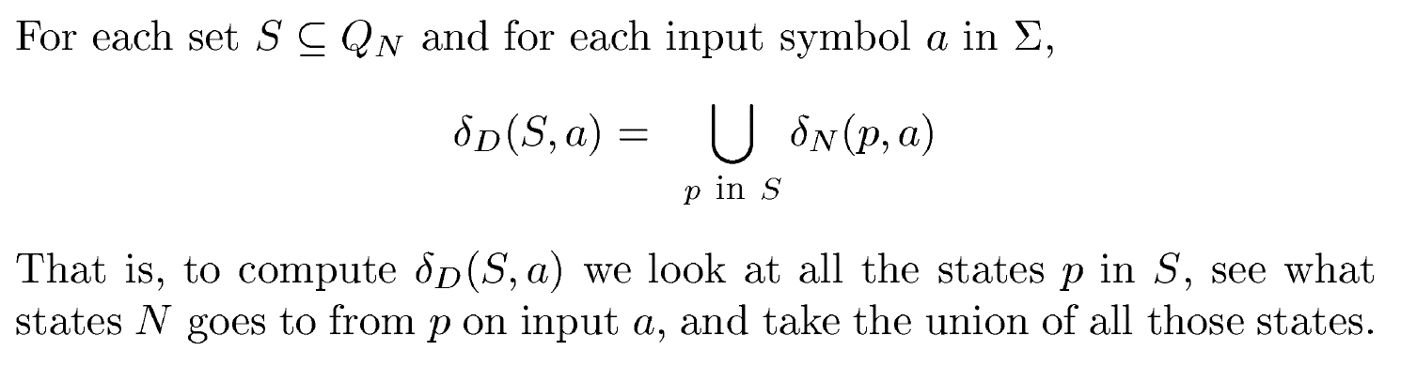
Subset Construction – (2)
The transition function δ_{D} is defined by:
δ_{D}({q₁,…,q_{k}}, a) is the union over all i = 1,…,k of δ_{N}(q_{i}, a).
Example: We’ll construct the DFA equivalent of our“chessboard”NFA.

Slide 79
Example: Subset Construction
r b
2,4 5
4,6 1,3,5
2,6 5
2,8 1,5,7
2,4,6,8 1,3,7,9
2,8 3,5,9
4,8 5
4,6 5,7,9
6,8 5
r b
{1}
{2,4} {5}
{2,4}
{5}
*
Alert: What we’re doing here is
the lazy form of DFA construction,
where we only construct a state
if we are forced to.

Slide 80
Example: Subset Construction
r b
2,4 5
4,6 1,3,5
2,6 5
2,8 1,5,7
2,4,6,8 1,3,7,9
2,8 3,5,9
4,8 5
4,6 5,7,9
6,8 5
r b
{1}
{2,4} {5}
{2,4}
{2,4,6,8} {1,3,5,7}
{5}
{2,4,6,8}
{1,3,5,7}
*

Slide 81
Example: Subset Construction
r b
2,4 5
4,6 1,3,5
2,6 5
2,8 1,5,7
2,4,6,8 1,3,7,9
2,8 3,5,9
4,8 5
4,6 5,7,9
6,8 5
r b
{1}
{2,4} {5}
{2,4}
{2,4,6,8} {1,3,5,7}
{5}
{2,4,6,8} {1,3,7,9}
{2,4,6,8}
{1,3,5,7}
* {1,3,7,9}
*

Slide 82
Example: Subset Construction
r b
2,4 5
4,6 1,3,5
2,6 5
2,8 1,5,7
2,4,6,8 1,3,7,9
2,8 3,5,9
4,8 5
4,6 5,7,9
6,8 5
r b
{1}
{2,4} {5}
{2,4}
{2,4,6,8} {1,3,5,7}
{5}
{2,4,6,8} {1,3,7,9}
{2,4,6,8}
{2,4,6,8} {1,3,5,7,9}
{1,3,5,7}
* {1,3,7,9}
* {1,3,5,7,9}
*

Slide 83
Example: Subset Construction
r b
2,4 5
4,6 1,3,5
2,6 5
2,8 1,5,7
2,4,6,8 1,3,7,9
2,8 3,5,9
4,8 5
4,6 5,7,9
6,8 5
r b
{1}
{2,4} {5}
{2,4}
{2,4,6,8} {1,3,5,7}
{5}
{2,4,6,8} {1,3,7,9}
{2,4,6,8}
{2,4,6,8} {1,3,5,7,9}
{1,3,5,7}
{2,4,6,8} {1,3,5,7,9}
* {1,3,7,9}
* {1,3,5,7,9}
*

Slide 84
Example: Subset Construction
r b
2,4 5
4,6 1,3,5
2,6 5
2,8 1,5,7
2,4,6,8 1,3,7,9
2,8 3,5,9
4,8 5
4,6 5,7,9
6,8 5
r b
{1}
{2,4} {5}
{2,4}
{2,4,6,8} {1,3,5,7}
{5}
{2,4,6,8} {1,3,7,9}
{2,4,6,8}
{2,4,6,8} {1,3,5,7,9}
{1,3,5,7}
{2,4,6,8} {1,3,5,7,9}
* {1,3,7,9}
{2,4,6,8} {5}
* {1,3,5,7,9}
*

Slide 85
Example: Subset Construction
r b
2,4 5
4,6 1,3,5
2,6 5
2,8 1,5,7
2,4,6,8 1,3,7,9
2,8 3,5,9
4,8 5
4,6 5,7,9
6,8 5
r b
{1}
{2,4} {5}
{2,4}
{2,4,6,8} {1,3,5,7}
{5}
{2,4,6,8} {1,3,7,9}
{2,4,6,8}
{2,4,6,8} {1,3,5,7,9}
{1,3,5,7}
{2,4,6,8} {1,3,5,7,9}
* {1,3,7,9}
{2,4,6,8} {5}
* {1,3,5,7,9}
{2,4,6,8} {1,3,5,7,9}
*

Slide 86
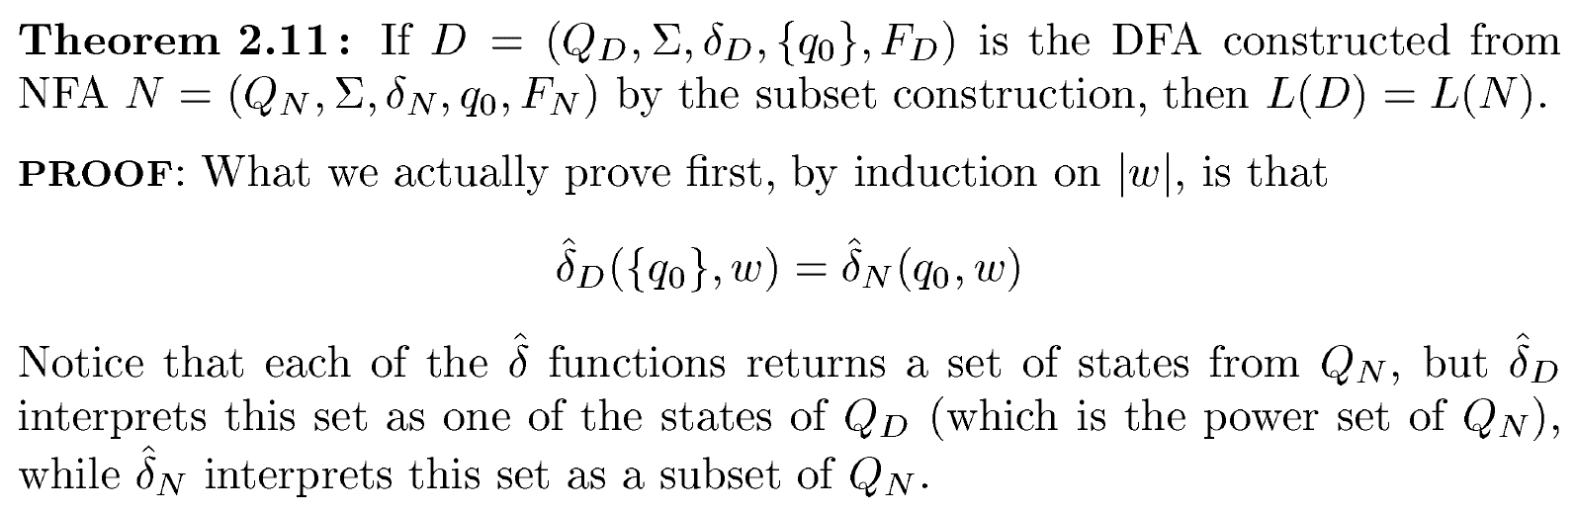
Proof of Equivalence: Subset Construction

Slide 87
Proof of Equivalence: Subset Construction
Show by induction on |w| that
δ_{N}(q₀, w) = δ_{D}({q₀}, w)
Basis: w = ε: δ_{N}(q₀, ε) = δ_{D}({q₀}, ε) = {q₀}.

Slide 88
Induction
Assume IH for strings shorter than w.
Let w = xa; IH holds for x.
Let δ_{N}(q₀, x) = δ_{D}({q₀}, x) = S.
Let T = the union over all states p in S of δ_{N}(p, a).
Then δ_{N}(q₀, w) = δ_{D}({q₀}, w) = T.

Slide 89
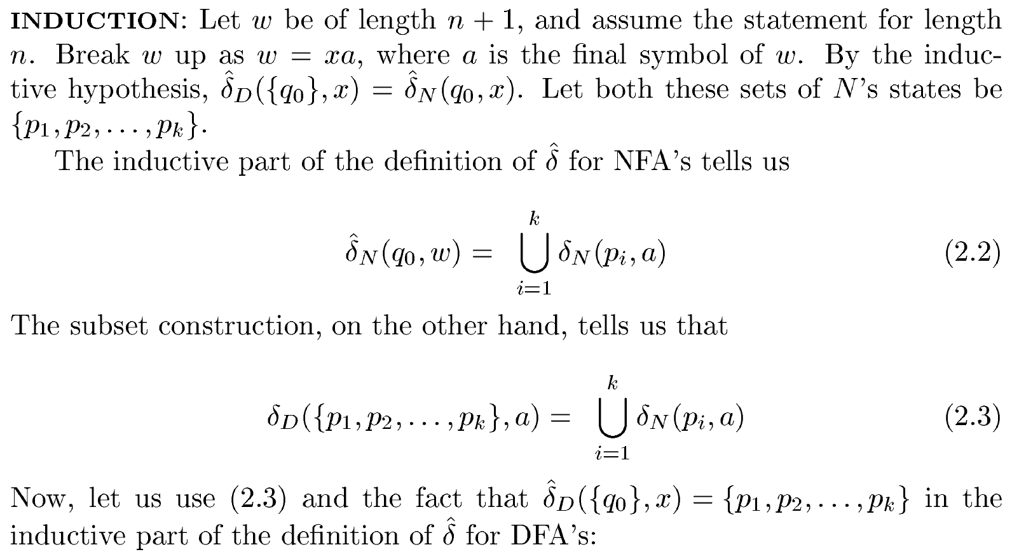
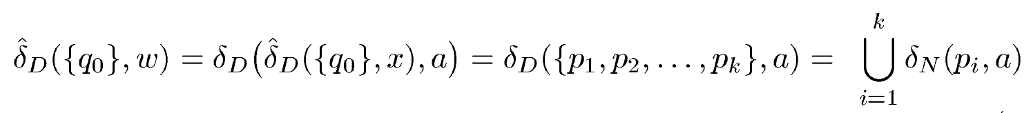
Induction

Slide 90
NFA with ε-Transition
We can allow state-to-state transitions on ε input.
These transitions are done spontaneously, without looking at the input string.
A convenience at times, but still only regular languages are accepted.

Slide 91
Example: ε-NFA
0 1 ε
A {E} {B} ∅
B ∅ {C} {D}
C ∅ {D} ∅
D ∅ ∅ ∅
E {F} ∅ {B, C}
F {D} ∅ ∅
ε
1
1
1
B
C
D
A
ε
*
ε
0
0
E
F
0

Slide 92
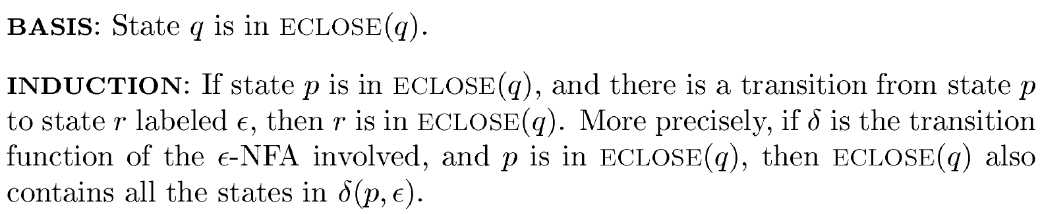
Closure of States
CL(q) = set of states you can reach from state q following only arcs labeled ε.

Slide 93
Closure of States
CL(q) = set of states you can reach from state q following only arcs labeled ε.
Example: CL(A) = {A};
CL(E) = {B, C, D, E}.
Closure of a set of states = union of the closure of each state.
ε
1
1
1
B
C
D
A
ε
ε
0
0
E
F
0

Slide 94
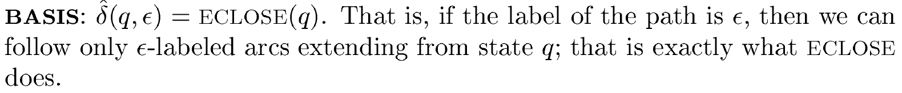
Extended Delta for ε-NFA

Slide 95
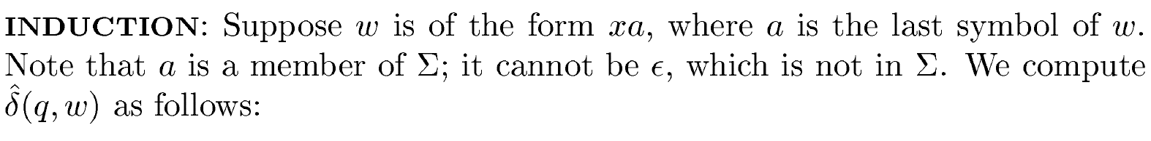
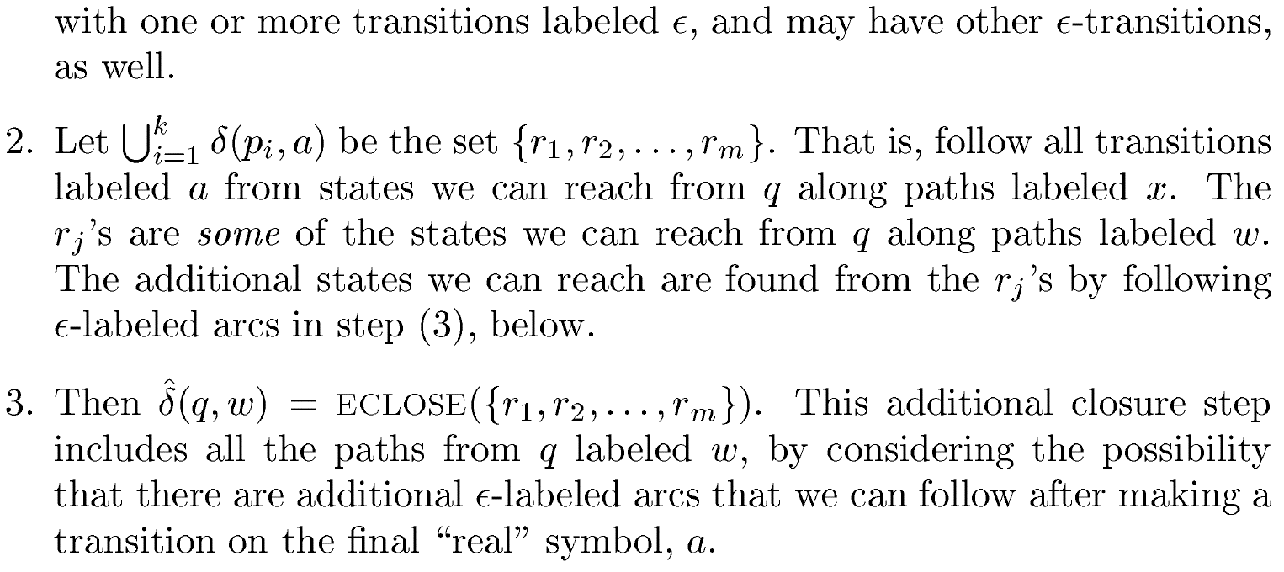
Extended Delta for ε-NFA

Slide 96
Extended Delta for ε-NFA
^
Intuition: δ_{E}(q, w) is the set of states you can reach from q following a path labeled w.
Basis: δ_{E}(q, ε) = CL(q).
Induction: δ_{E}(q, xa) is computed by:
Start with δ_{E}(q, x) = S.
Take the union of CL(δ_{E}(p, a)) for all p in S.
^
^
^

Slide 97
ε
Example: Extended Delta
1
1
1
B
C
D
A
ε
ε
^
0
δ_{E}(A, ε) = CL(A) = {A}
δ_{E}(A, 0) = CL({E}) = {B, C, D, E}
δ_{E}(A, 01) = CL({C, D}) = {C, D}
Language of an ε-NFA is the set of strings w such that δ_{E}(q₀, w) contains a final state.
0
E
F
^
0
^
^

Slide 98
Equivalence of NFA, ε-NFA
Every NFA is an ε-NFA.
It just has no transitions on ε.
Converse requires us to take an ε-NFA and construct an NFA that accepts the same language.
We do so by combining ε–transitions with the next transition on a real input.

Slide 99
Picture of ε-Transition Removal
To here
a
We’ll go
from here
a
a
Transitions
on ε
Transitions
on ε

Slide 100
Equivalence of NFA, ε-NFA – (2)
Start with an ε-NFA with states Q, inputs Σ, start state q₀, final states F, and transition function δ_{E}.
Construct an “ordinary” NFA with states Q, inputs Σ, start state q₀, final states F’, and transition function δ_{N}.

Slide 101
Equivalence of NFA, ε-NFA – (3)
Compute δ_{N}(q, a) as follows:
Let S = CL(q).
δ_{N}(q, a) is the union over all p in S of δ_{E}(p, a).
F’ = the set of states q such that CL(q) contains a state of F.

Slide 102
Equivalence of NFA, ε-NFA – (3)
Prove by induction on |w| that
CL(δ_{N}(q₀, w)) = δ_{E}(q₀, w).
Thus, the ε-NFA accepts w if and only if the “ordinary” NFA does.
^

Slide 103
Interesting
closures: CL(B)
= {B,D}; CL(E)
= {B,C,D,E}
Example: ε-NFA-to-NFA
0 1 ε
A {E} {B} ∅
B ∅ {C} {D}
C ∅ {D} ∅
D ∅ ∅ ∅
E {F} ∅ {B, C}
F {D} ∅ ∅
Doesn’t change,
since B, C, D
have no trans-
itions on 0.
0 1
A {E} {B}
B ∅ {C}
C ∅ {D}
D ∅ ∅
E {F} {C, D}
F {D} ∅
*
*
*
*
Since closure of
E includes B and
C; which have
transitions on 1
to C and D.
ε-NFA
Since closures of
B and E include
final state D.

Slide 104
Summary
DFA’s, NFA’s, and ε–NFA’s all accept exactly the same set of languages: the regular languages.
The NFA types are easier to design and may have exponentially fewer states than a DFA.
But only a DFA can be implemented!

Slide 105
You Are Welcome
Any Question?

